Slide 1


Preview to MAUI
(Multi-platform App UI)
Week 1
© COGNIZANT SOFTVISION 2021

Slide 2
https://github.com/Magenic/MAUIPreview

Slide 3
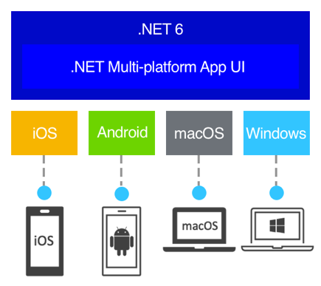
MAUI – The Xamarin Underpinning
Xamarin now .NET Core Workload
Namespace Changes
iOS and Android Now Targets
Apple and Google APIs Directly Wrapped
Sits on top of .Net BCL

Slide 4
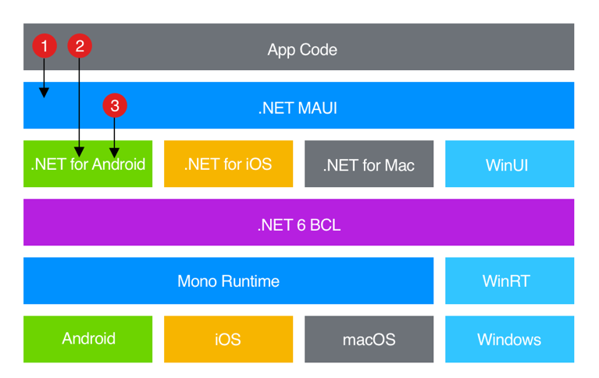
MAUI – Platforms
iOS
Android
macOS apps use Mac Catalyst
Windows uses WinUI
Linux (separate project)

Slide 5
Major Changes
Single project Structure
MVVM, MVU (Comet) and Mobile Blazor Bindings
Old Renderer System Replaced
Mixture of native and custom controls – multiple UI options
Hot Reload

Slide 6
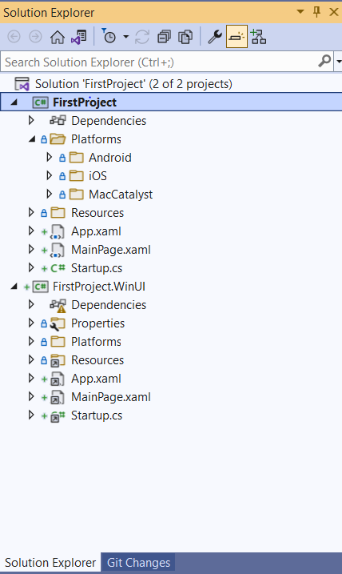
Single Project Structure
Single project for iOS, Android and MacOS
Separate Windows project with linked files
Shared Resources
But still the same Xamarin.Forms Xaml

Slide 7
Starting a Maui Project
public class Startup : IStartup
{
public void Configure(IAppHostBuilder appBuilder)
{
appBuilder .UseMauiApp<App>();
}
}
public partial class App : Application
{
public App()
{
InitializeComponent();
MainPage = new MainPage();
}
}
App class extends Microsof.Maui.Controls.Application

Slide 8
Demo 1 – Looking at the default process
Still requires CLI - dotnet new maui -n FirstProject

Slide 9
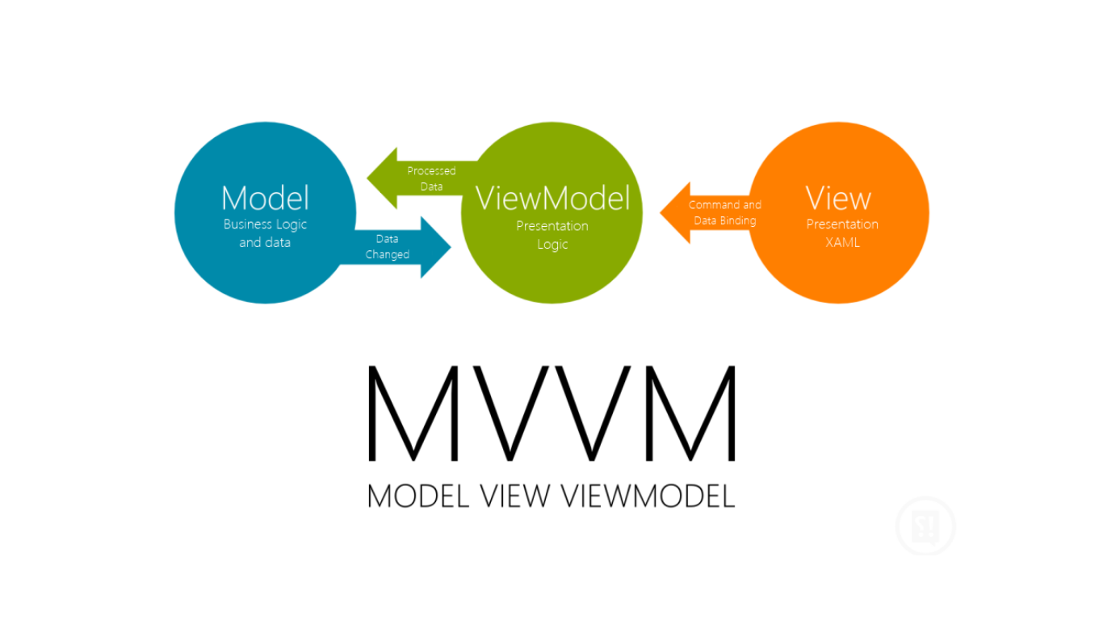



MVVM, MVU and Mobile Blazor Bindings
MVVM - Default Xaml and C# controls, multiple frameworks
https://github.com/dotnet/maui
MVU – fabulous or Comet (separate projects)
https://fabulousfx.github.io/
https://github.com/dotnet/Comet
Experimental Blazor Mobile Bindings, BlazorWebView to embed Blazor apps
https://github.com/dotnet/MobileBlazorBindings

Slide 10
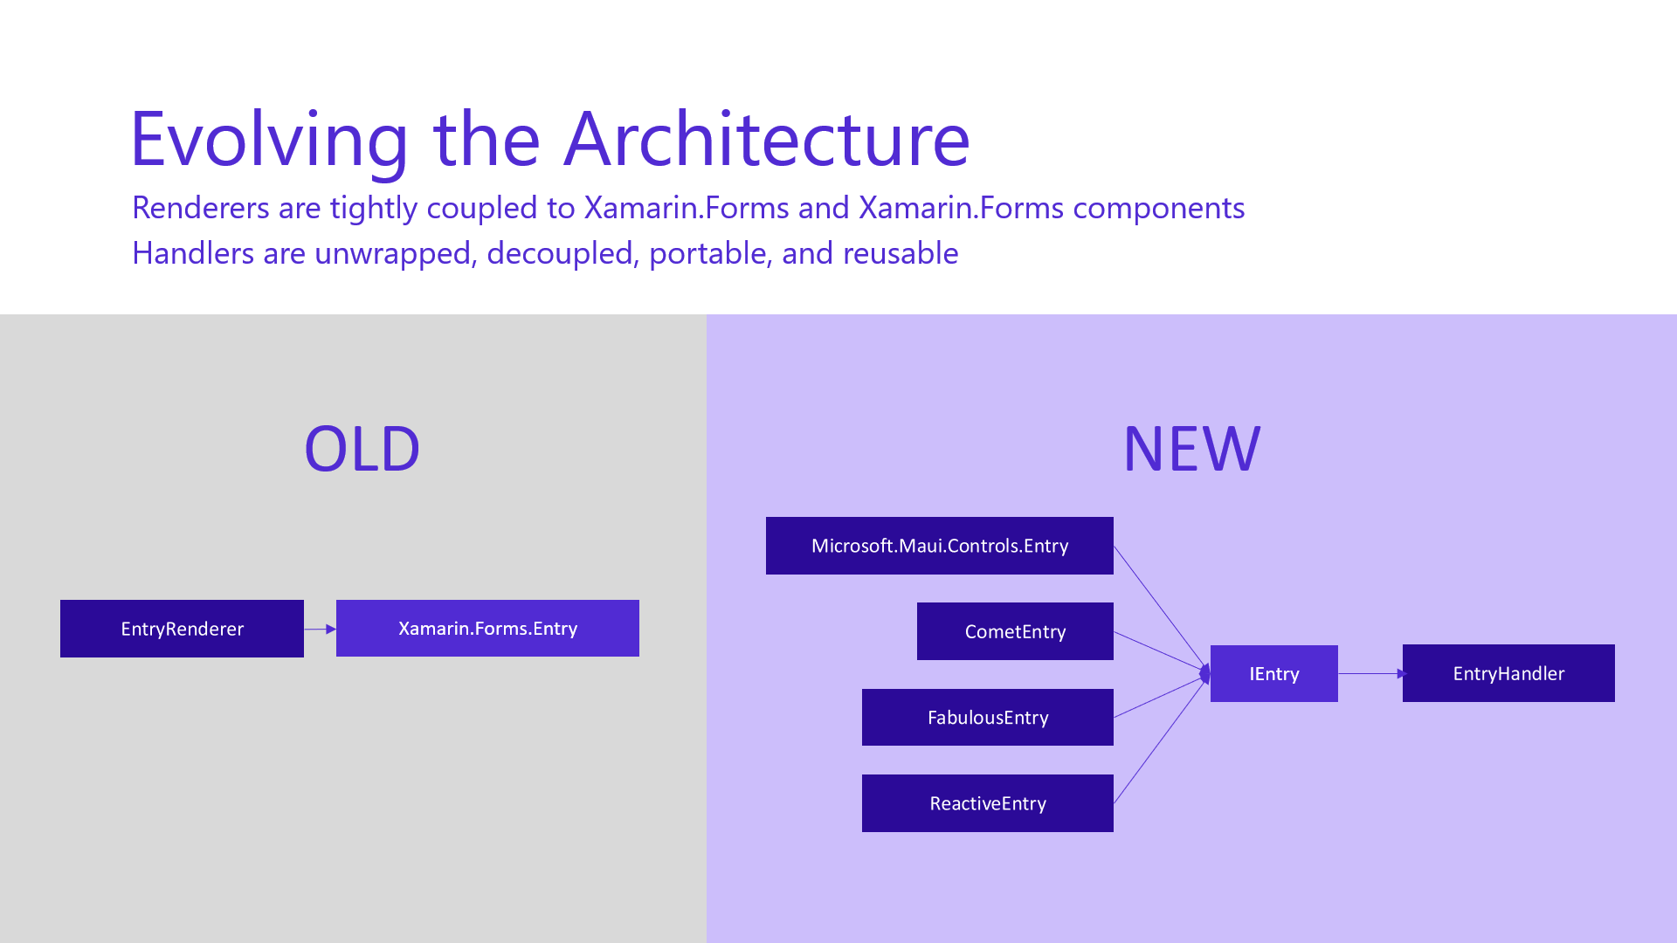
Replaced Renderer System
Handler Architecture
Decouples Framework from Native Controls
Less views rendered
Platform Controls handle needs of framework

Slide 11
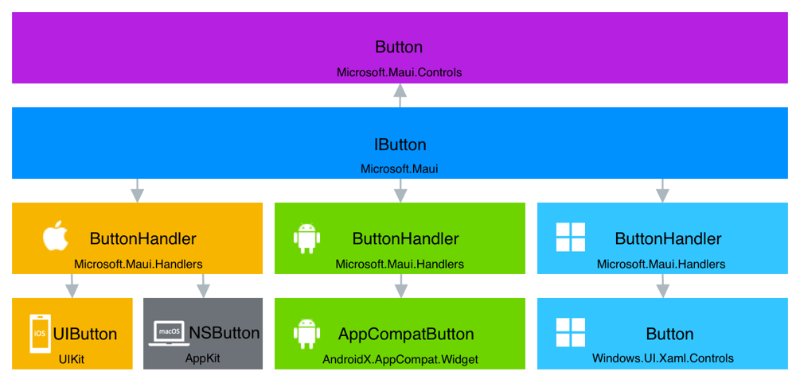
Mapper

Slide 12
Demo 2 – Custom Handlers

Slide 13
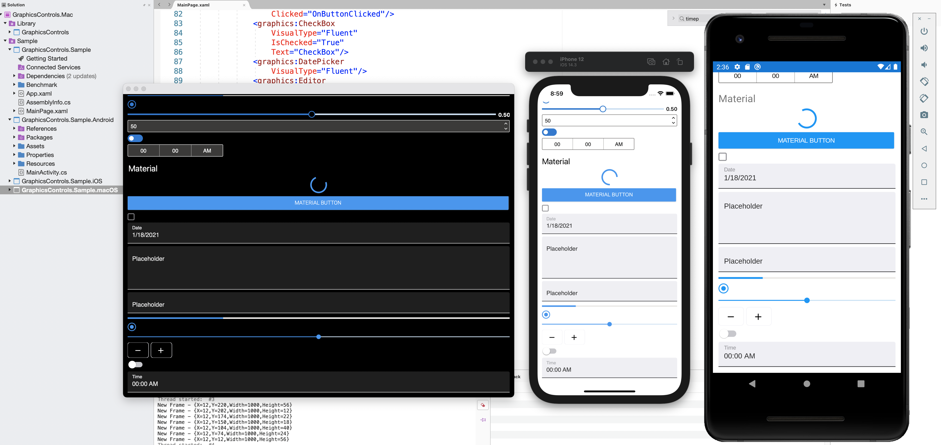
Alternate UIs
Early, early preview
Built on Microsoft.Maui.Graphics
Cupertino, Fluent and Material
Github project does not compile
https://github.com/dotnet/Microsoft.Maui.Graphics.Controls

Slide 14
Installing
https://devblogs.microsoft.com/dotnet/announcing-net-maui-preview-6/
https://docs.microsoft.com/en-us/dotnet/maui/get-started/first-app?pivots=windows
Install Android Emulator and SDK
We will not be working with iOS for this class

Slide 15
For Next Week, have MAUI installed

